Slide 1
PROJECT BLIND EYE
9-17
TAN KWANG YIK TREMAINE (Leader) [4P3]
KHNG ASHLEY [4P3]
Notes:
Tremaine: Good morning Judges, we are “Project Blind Eye”, and this project is made up of 2 members, Me and Ashley. The name was inspired by the purpose of this project, which is to create a third eye for the visually impaired.

Slide 2
Brief Introduction To Project Blind Eye
Notes:
Tremaine: To start, we will briefly introduce you to Project Blind Eye!

Slide 3
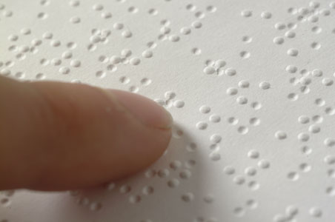
Problem Observed in Society
Blind people generally have lower literacy rates
High unemployment of blind adults
High dropout rates of blind high school students
Majority of physical books obviously cater to the visually blessed
Notes:
Tremaine: The main problems that blind people have faced are that they have lower literacy rates that mostly lead to higher unemployment and higher dropout rates. It is often argued that Braille can solve this problem, but majority of educational physical books are not published in Braille, hence highlighting the problem.

Slide 4

Objective
We aim to create a tool which aids blind people in reading contents on a paper out loud, be it text or images
Notes:
Tremaine: With this problem in mind, our project aims to implement a product to enable blind people to read visual content on a paper through a speaker, including both text and images. This allows blind people to read books, thus solving the problem of low literacy rates.
(ASHLEY UNMUTE MIC - Following Slide)

Slide 5


Target Audience
We are targeting blind people above 12 yrs old
Reason: Users below 12 might need the basic skills of using the product.
Notes:
Tremaine: This project targets blind people above 12 years old as those below 12 may not have the basic skills to use the product
(STOP HERE)

Slide 6
Literature Review
Notes:
Ashley: Moving on to our literature review, …………………..

Slide 7
Literature Review
1) Literacy rates of legally blind people are very low
Less than 10% of people who are legally blind in the US are Braille Readers (“The Braille Literacy Crisis in America”, 2009)
Only 10% of blind children are learning Braille (“The Braille Literacy Crisis in America”, 2009)
Our project is important as society does not accept this severe illiteracy rate
Notes:
Ashley: …….. The first review proves that literacy rates of legally blind people are extremely low. We can infer from the report that not much has been done to curb this problem of low literacy rates. This proves that our project would be very useful since society does not accept the illiteracy that leads to unemployment.

Slide 8
Literature Review
2) It is difficult for blind people to find jobs as there are insufficient tools to educate blind people
Less than 70% of blind adults are unemployed (“The Braille Literacy Crisis in America”, 2009)
Close to 50% of blind high school students dropout of high school. (“The Braille Literacy Crisis in America”, 2009)
Notes:
Ashley: Moving on, it is also difficult for blind people to find jobs as there are insufficient tools to educate blind people. Employers do not know if these blind people have basic skills and they usually do not hire the visually impaired as it may be harder for them to work, especially in areas that require visual skill.

Slide 9
Literature Review
3) Literacy rates of blind people are a great considering factor for successful employment
According to the US Department of Labour, literacy problems has $225 billion cost in loss of productivity, injuries and mistakes in businesses. (“The Braille Literacy Statistics and How They Relate to Equality”, 2016)
Notes:
Ashley: Lastly, the literacy rates of blind people affects very much about whether one is successfully employed. From the statistics, we can see that literacy is very important in the workforce, and only with the presence of our project can these blind people break the reading barrier in order to have a chance to contribute to society.

Slide 10
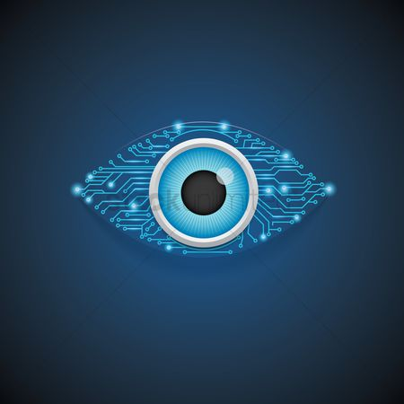
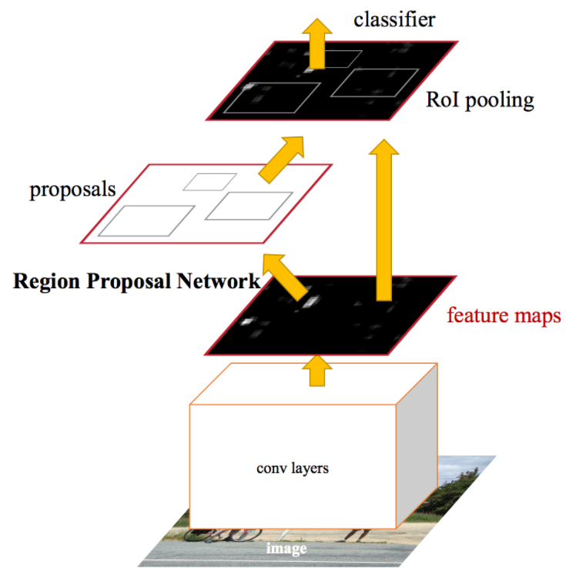
Object Detection Algorithms
YOLO - You Only Look Once
Faster R-CNN
SSD - Single Shot Detectors
Notes:
Ashley: Furthermore, we conducted an object detection write-up to research on the different types of algorithms as our group is new to object detection.We will only be showing a snippet of our research as the full research is long and can be found in our github. We found out that there are 3 main families of algorithms, YOLO, RCNN, and SSD. Within RCNN, we chose to research in depth only for Faster RCNN, and not for the others like Mask RCNN.

Slide 11
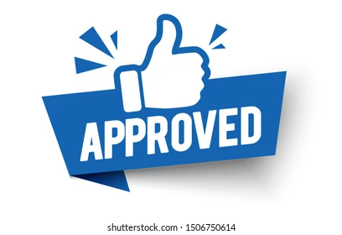
Why we chose YOLO?
YOLO - You Only Look Once
Designed for speed and real-time use
Very suitable for this project as speed is a very important consideration factor
Also excellent at detecting really small objects
Notes:
Ashley: Here’s why we chose YOLO. It is designed for speed and real-time use, meaning that we can complete the processing of image in milliseconds and it is also great at detecting small objects which is useful for our project

Slide 12

Why not SSD or RCNN?
Faster RCNN
Training data is too long
Training happens in multiple phases
Network is too slow at inference time
SSD - Single Shot Detectors
Has problems detecting small objects
Unsuitable for our project because we require high proficiency in scanning small objects on physical paper
Notes:
Ashley: After our research, we also learnt that RCNN has disadvantages that can compromise our project such as its training data being too long, and the network being really slow at the inference time. SSD is also inferior as it has lower success rates when detecting small objects, which can compromise our project since images on paper can be printed really small.

Slide 13
Case Studies
Notes:
Ashley: Our next section would be the Case Studies

Slide 14
KNFB Reader
App Description (Sensotec, 2020)
An app which aids the visually impaired in reading text on documents using OCR technology
Comparison to our project
This app does not even include hardware and only reads text but already costs $100
Our project has higher functionality and includes hardware for the user
https://play.google.com/store/apps/details?id=com.sensotec.knfbreader&hl=en_SG&gl=US
Notes:
Ashley: The first case study is an android app on Google Play. It is an app that uses OCR to read out text in an image. However, we think that our project is superior as this app is very expensive, priced at $100 when it does not even include any kind of hardware! Furthermore, this app does not have any kind of object detection functionality unlike our project.

Slide 15
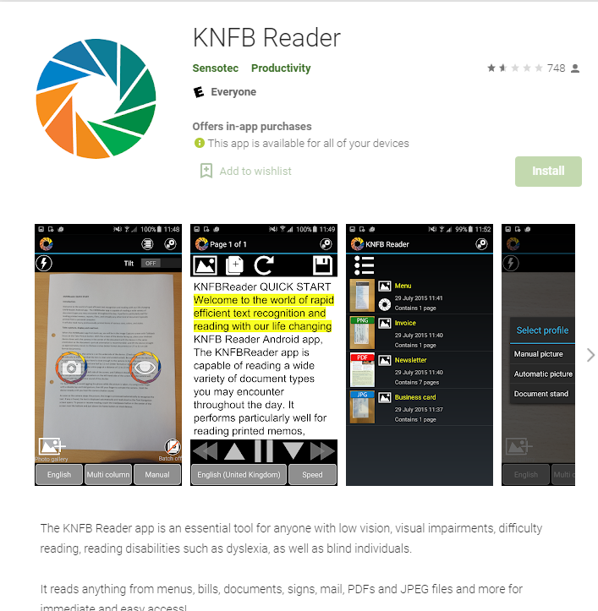
KNFB Reader
Notes:
Ashley: Here’s an image of the app on Google Play

Slide 16
Subtitle Reader
App Description (Martin, 2017)
An app posted on hackaday.io
Uses OCR and a camera on a smartphone or tablet to recognise the text on screen and transforms it into audio
Comparison to our project
Subtitle reader does not read objects in the image taken by the OCR Camera
The blind people would only have access to text captured by the camera
https://hackaday.io/project/21294-subtitle-reader
Notes:
Ashley: The second case study would be subtitle reader, which is an app posted on hackaday.io. Again, compared to our project, it does not have image detection functionality.

Slide 17
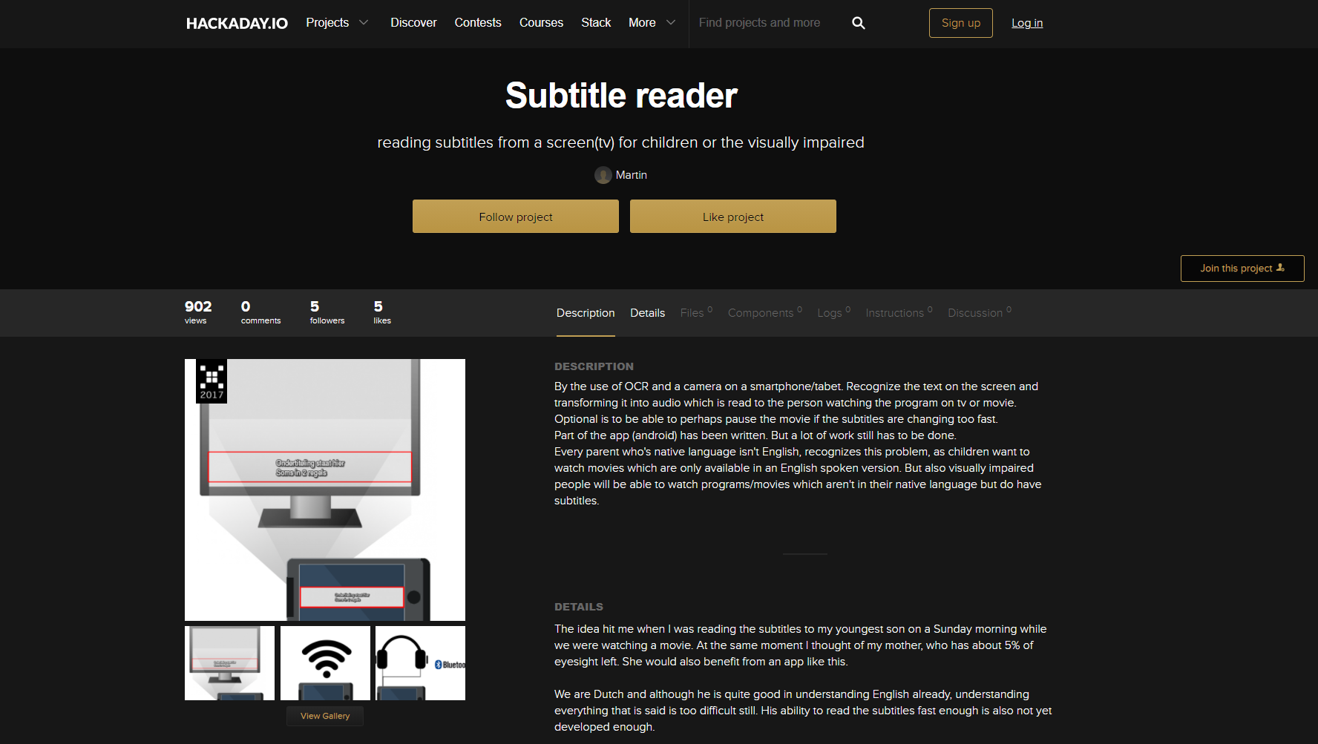
Subtitle Reader
Notes:
Ashley: Here’s how the app looks like on hackaday.io

Slide 18
Deaf-Blind Communication
App Description (Samir, 2017)
A project made in Arduino which aids communication between deaf and blind people
The blind person can hear what is played while the deaf person can see what is shown on the screen
Comparison to our project
Again, this has a limited functionality as it only allows text transmission, and not images
https://create.arduino.cc/projecthub/skyseeker/deaf-blind-communication-with-1sheeld-arduino-bb3362?ref=tag&ref_id=blind&offset=4
Notes:
Ashley: Our last case study is the Deaf Blind Communication Product on the arduino project hub. It allows a blind person to talk to a deaf person by talking, and the text will show on the screen for the deaf person to see. On the other hand, the deaf person can type on a keyboard and it will speak out the text for the blind person to hear. Compared to our project, this also only allows both parties to access only text data and not images.
(TREMAINE UNMUTE MIC)

Slide 19
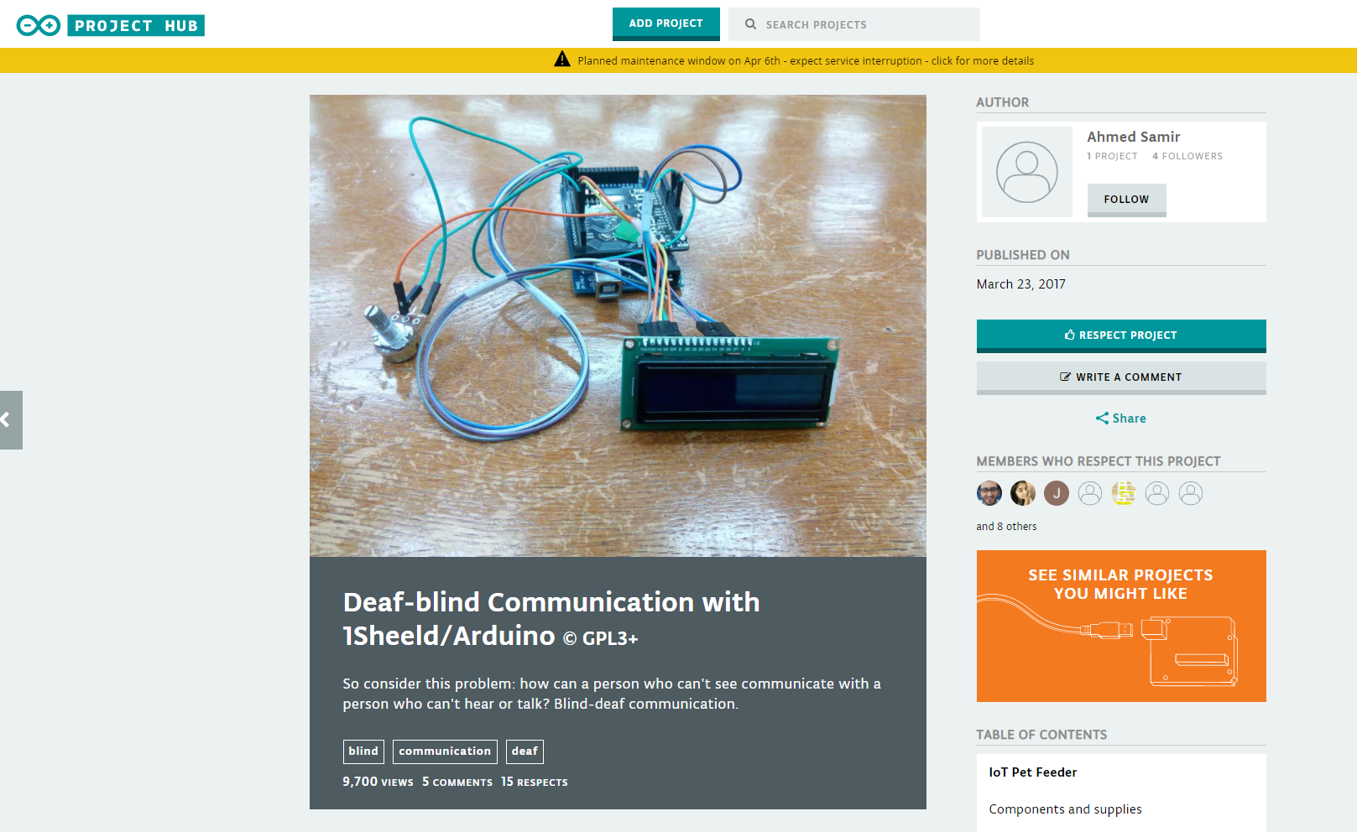
Deaf-Blind Communication
Notes:
Ashley: Here’s how the app looks like on the arduino project hub (STOP HERE)

Slide 20
Area Of Work
Notes:
Tremaine: Now we will move on to our next section, our area of work.

Slide 21
Live Demonstration
Notes:
Tremaine: Moving on, I’ll be performing a live demonstration. We have a pre-recorded version on our github. You can now pin the other user with the camera on that shows the prototype while I run the program.

Slide 22
Product Description
Scanner
A scanner that has all the functional components
Stand
A stand for the scanner to sit on such that the camera faces down to look at a piece of paper/book on a flat surface.
Notes:
Tremaine: I will start of by describing our product. Our project has 2 modules, the scanner and the stand. The scanner includes all the functionality of the project, with a camera, button, and speaker accessible to the user. The components will be shown in detail later on. The second module would be a 3D printed stand, which is a platform for the scanner to sit on such that the camera can view the contents of the document.

Slide 23
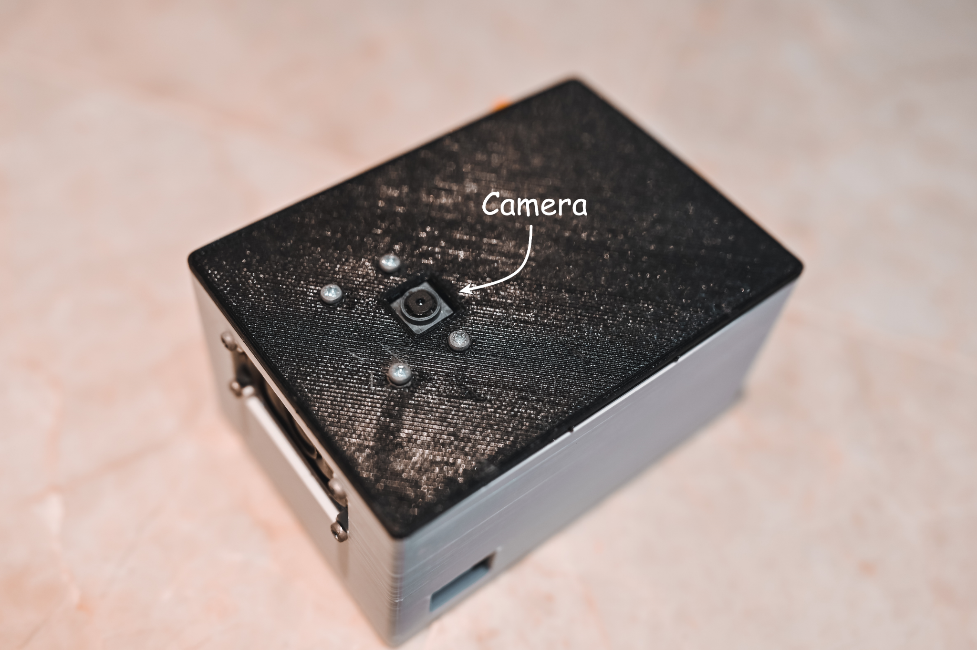
Product Description
Notes:
Tremaine: Here is a picture of the scanner. (This is the top view of the scanner)

Slide 24
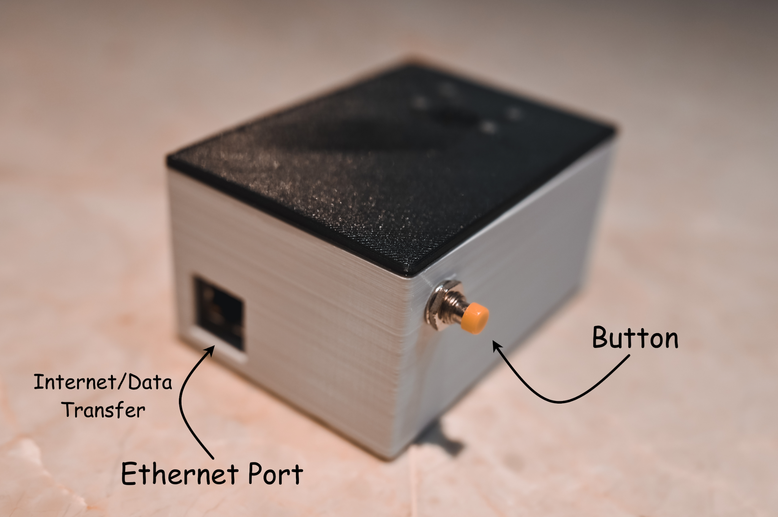
Product Description
Notes:
Tremaine: I will be introducing the… (The diagonal view)

Slide 25
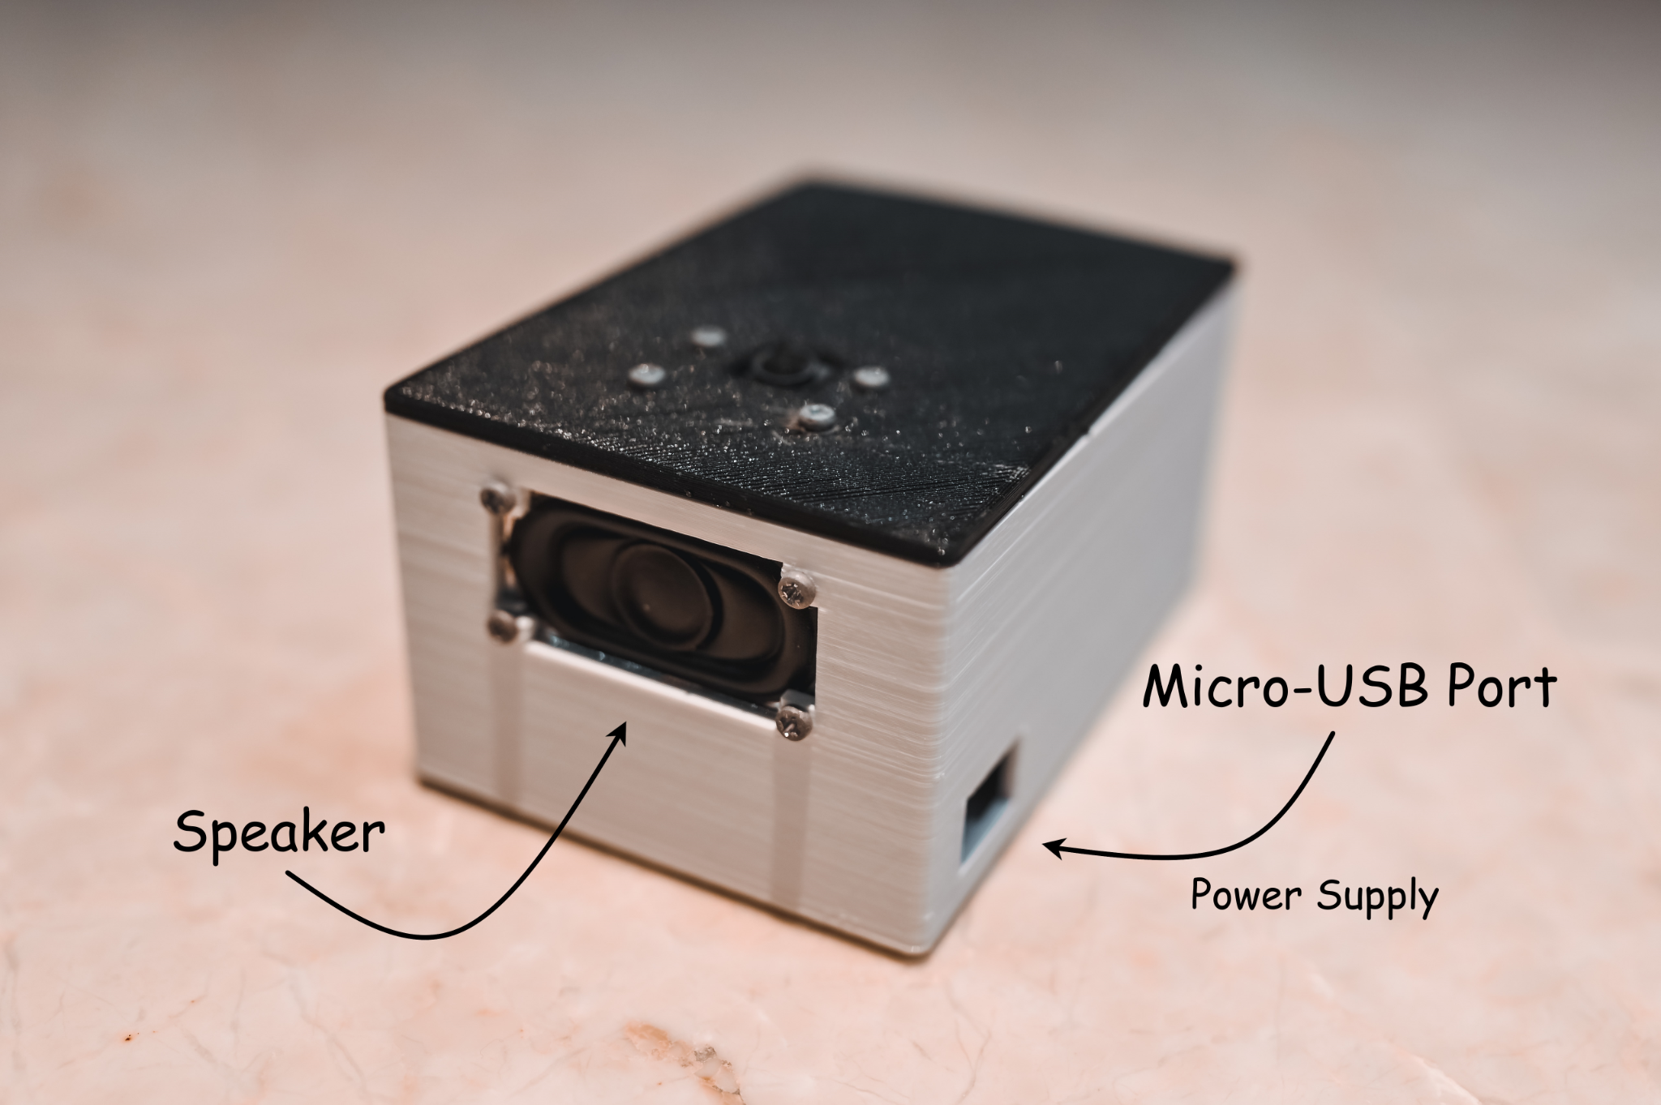
Product Description
Notes:
Tremaine: ..individual components in detail later (Another diagonal view)

Slide 26
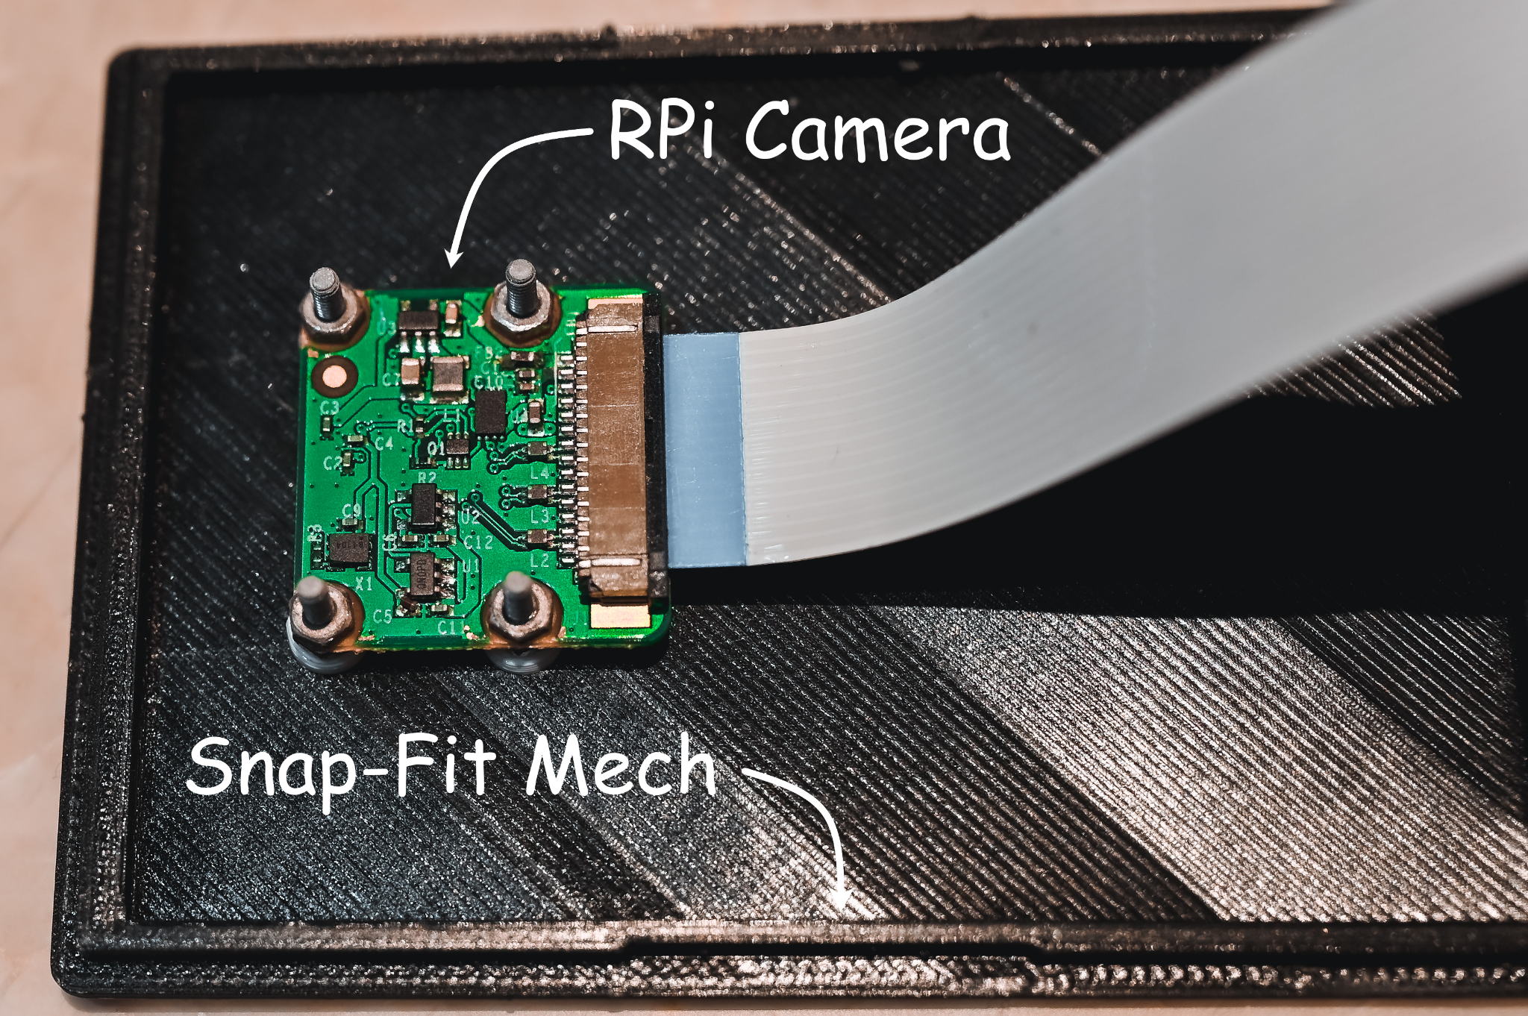
Product Description
Notes:
Tremaine: Here are some more pictures… (And the camera board inside the scanner)

Slide 27
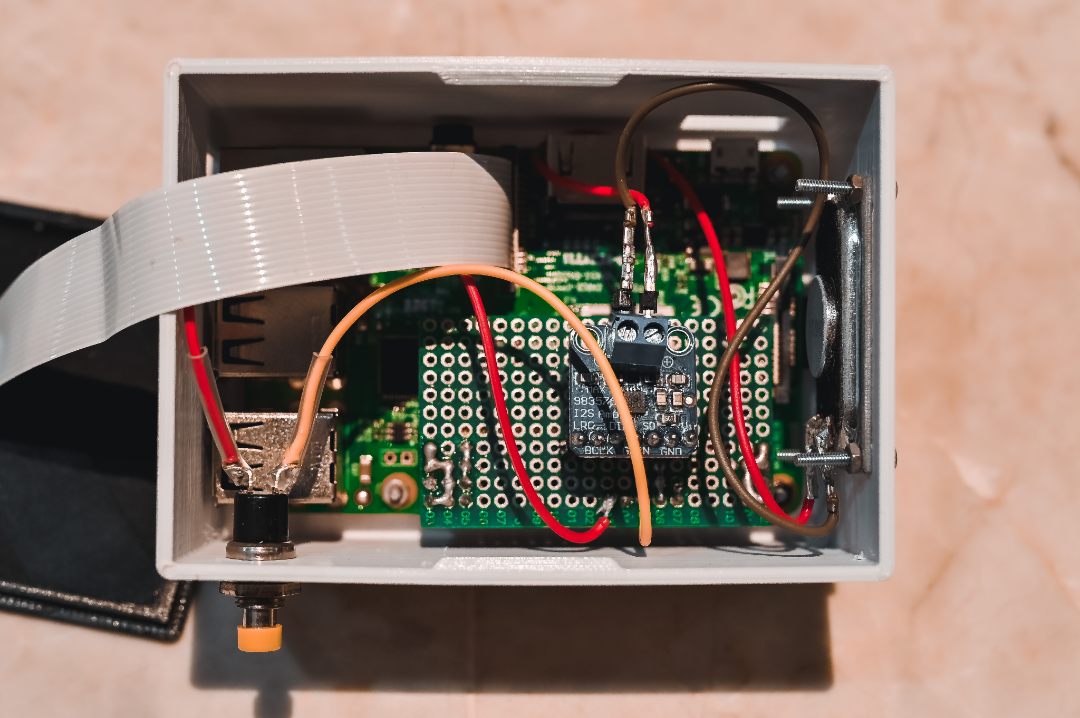
Product Description
Notes:
Tremaine: … (This is how the scanner looks like inside)

Slide 28
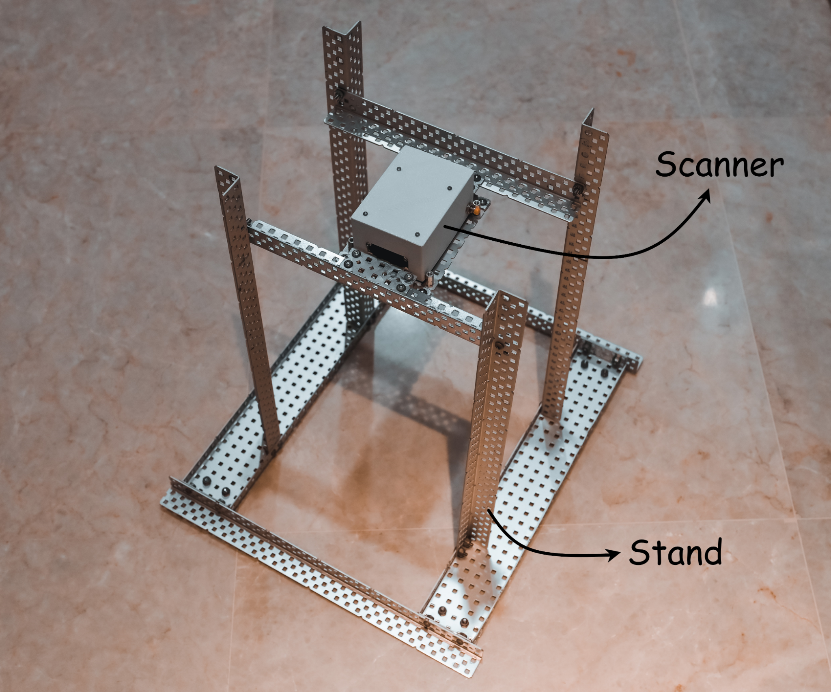
Product Description
Notes:
Tremaine: and a picture of the final prototype of our stand.

Slide 29
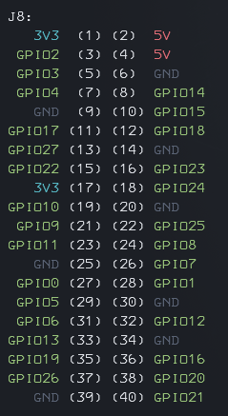
Functionality
A button connected to the GPIO pins of the Raspberry Pi is pressed
The Camera Module V2.1 captures a picture
Uses Raspberry Pi Built in Python picamera library
Notes:
Tremaine: Next, we will introduce the process of the entire program. Firstly, a button connected to the GPIO pins will be pressed, triggering the camera component to capture a picture using the picamera library.

Slide 30

Functionality
The picture is processed by our program in 2 sections
Object Detection - OpenCV
Library Used - opencv-contrib-python version 4.1.0.25 (YOLO Library)
Newest version is bugged in RPi Full Image
Optical Character Recognition - Tesseract
Uses pytesseract python library
Notes:
Tremaine: The picture captured is saved into a file and processed by 2 processing units, the object detection one and the OCR one. The object detection unit uses the opencv python library while the OCR unit using the pytesseract python library. Since we have two units, we used multi-threading to concurrently perform both units to speed up the program.

Slide 31
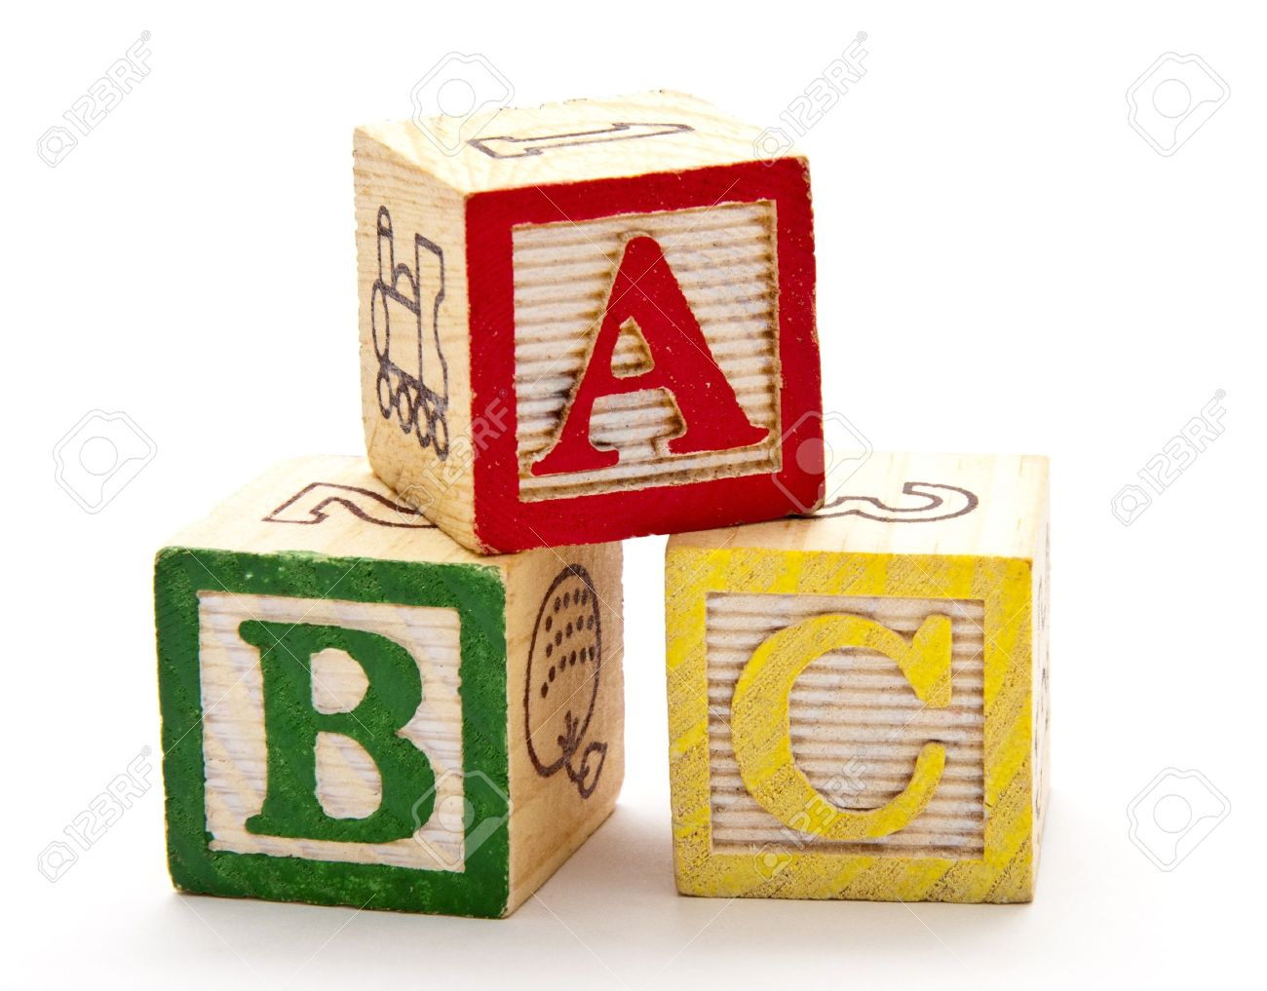
Functionality
Objects detected by OpenCV is converted into a sentence that describes what objects are in the image
Example: “The image contains a banana, two bottles, and an umbrella”
Mostly self-invented code
Only uses cmudict python library to differentiate between when to use “a”, and when to use “an”
Notes:
Tremaine: After scanning, we will have 2 sets of data the objects and the text. We will then generate a sentence that describes all the objects in the picture, for example: The image contains a banana, two bottles, and an umbrella. This piece of code uses the library cmudict to evaluate when we are supposed to use a, and when we use an to describe a certain object.

Slide 32


Functionality
All the text including the sentence and the OCR text is converted into a stereo audio file using TTS technology
gTTS python library is used
Although the most popular approach is pyttsx3, we chose gTTS because the pyttsx3 voice on RPi sounds robotic
Lastly, the audio file is read out through the speaker using the I2S Interface
Notes:
Tremaine: The sentence generated earlier will be converted to an audio file using the Google Text To Speech python library and played out using the I2S interface. We will not be use the most common approach, which is pyttsx3, because the voice sounds robotic and hard to understand.

Slide 33
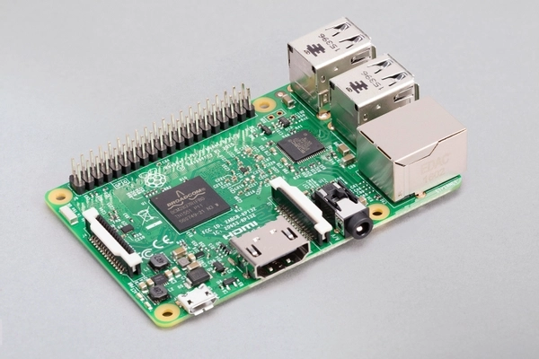
Hardware Components
Raspberry Pi Model 3B
Notes:
Tremaine: Next up, we will be listing all the components used. The RPi Model 3B acts as the brain of the program.

Slide 34
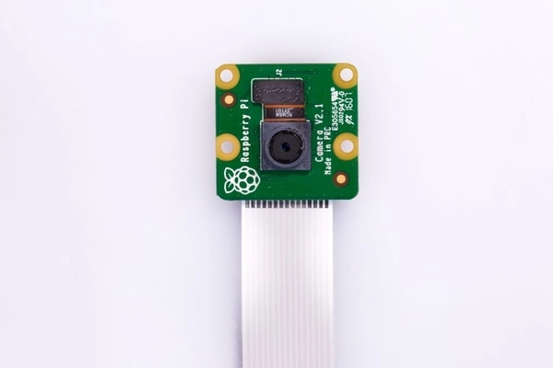
Hardware Components
Raspberry Pi Camera Module V2.1
Notes:
Tremaine: ...while the RPi Camera Module V2.1 captures the picture,

Slide 35
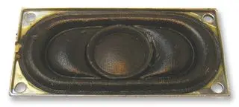
Hardware Components
ABS-224-RC Speaker
2W 4Ω
Notes:
Tremaine: The ABS-224-RC speaker is used to play audio for the user.

Slide 36
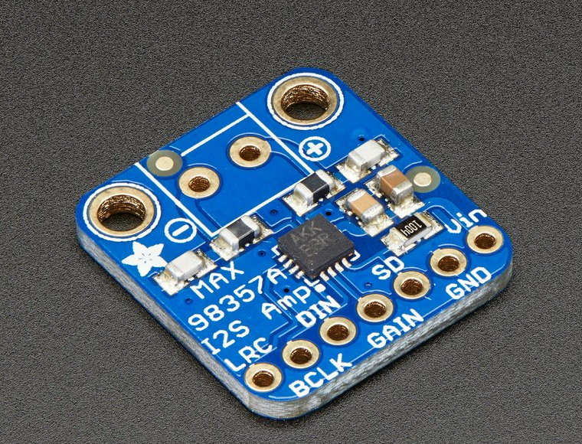
Hardware Components
Adafruit I2S 3W Class D Amplifier Breakout MAX98357A
Notes:
Tremaine: ….which is integrated with this Adafruit Amplifier that helps to play stereo audio loudly and clearly for the user

Slide 37
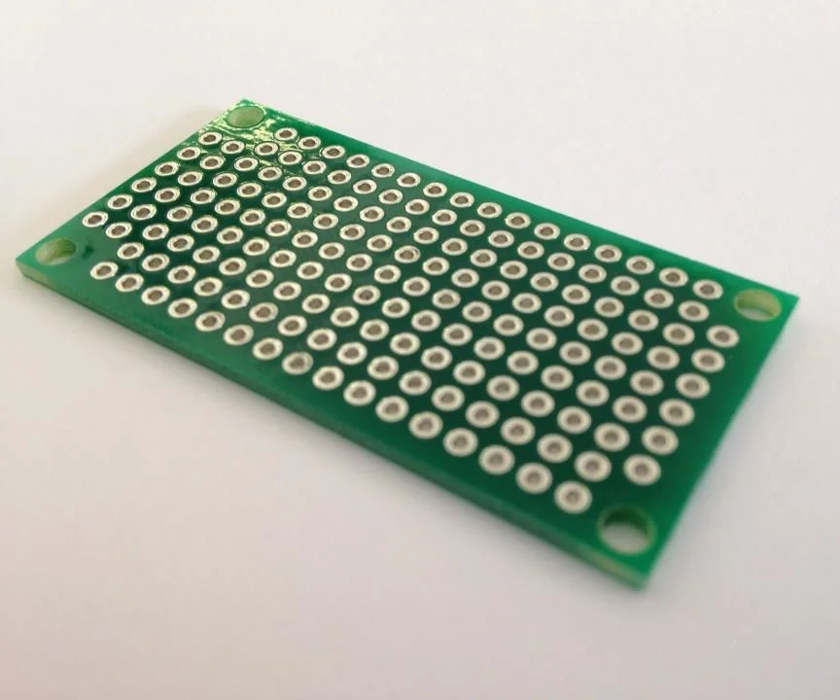
Hardware Components
Custom-Made Circuit Board to wire up all the components
Notes:
Tremaine: We also hand-soldered a circuit board to wire up all the components

Slide 38
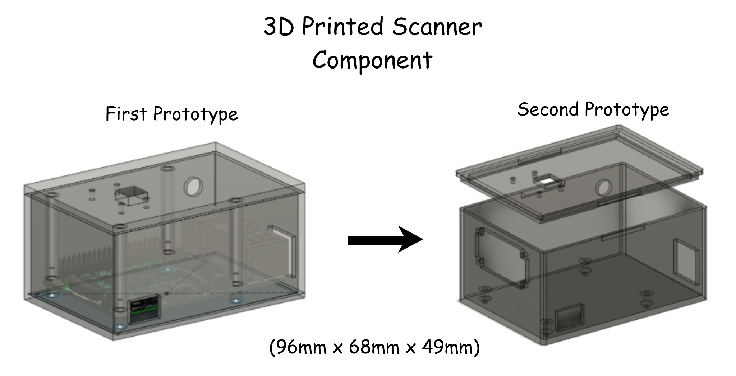
Hardware Components
3D Printed Scanner Casing
Notes:
Tremaine: …… All those components are then put into this 3D modelled scanner casing. Here are our two prototypes. The final one has a sleek snap-fit design that reduces plastic and looks nicer.

Slide 39
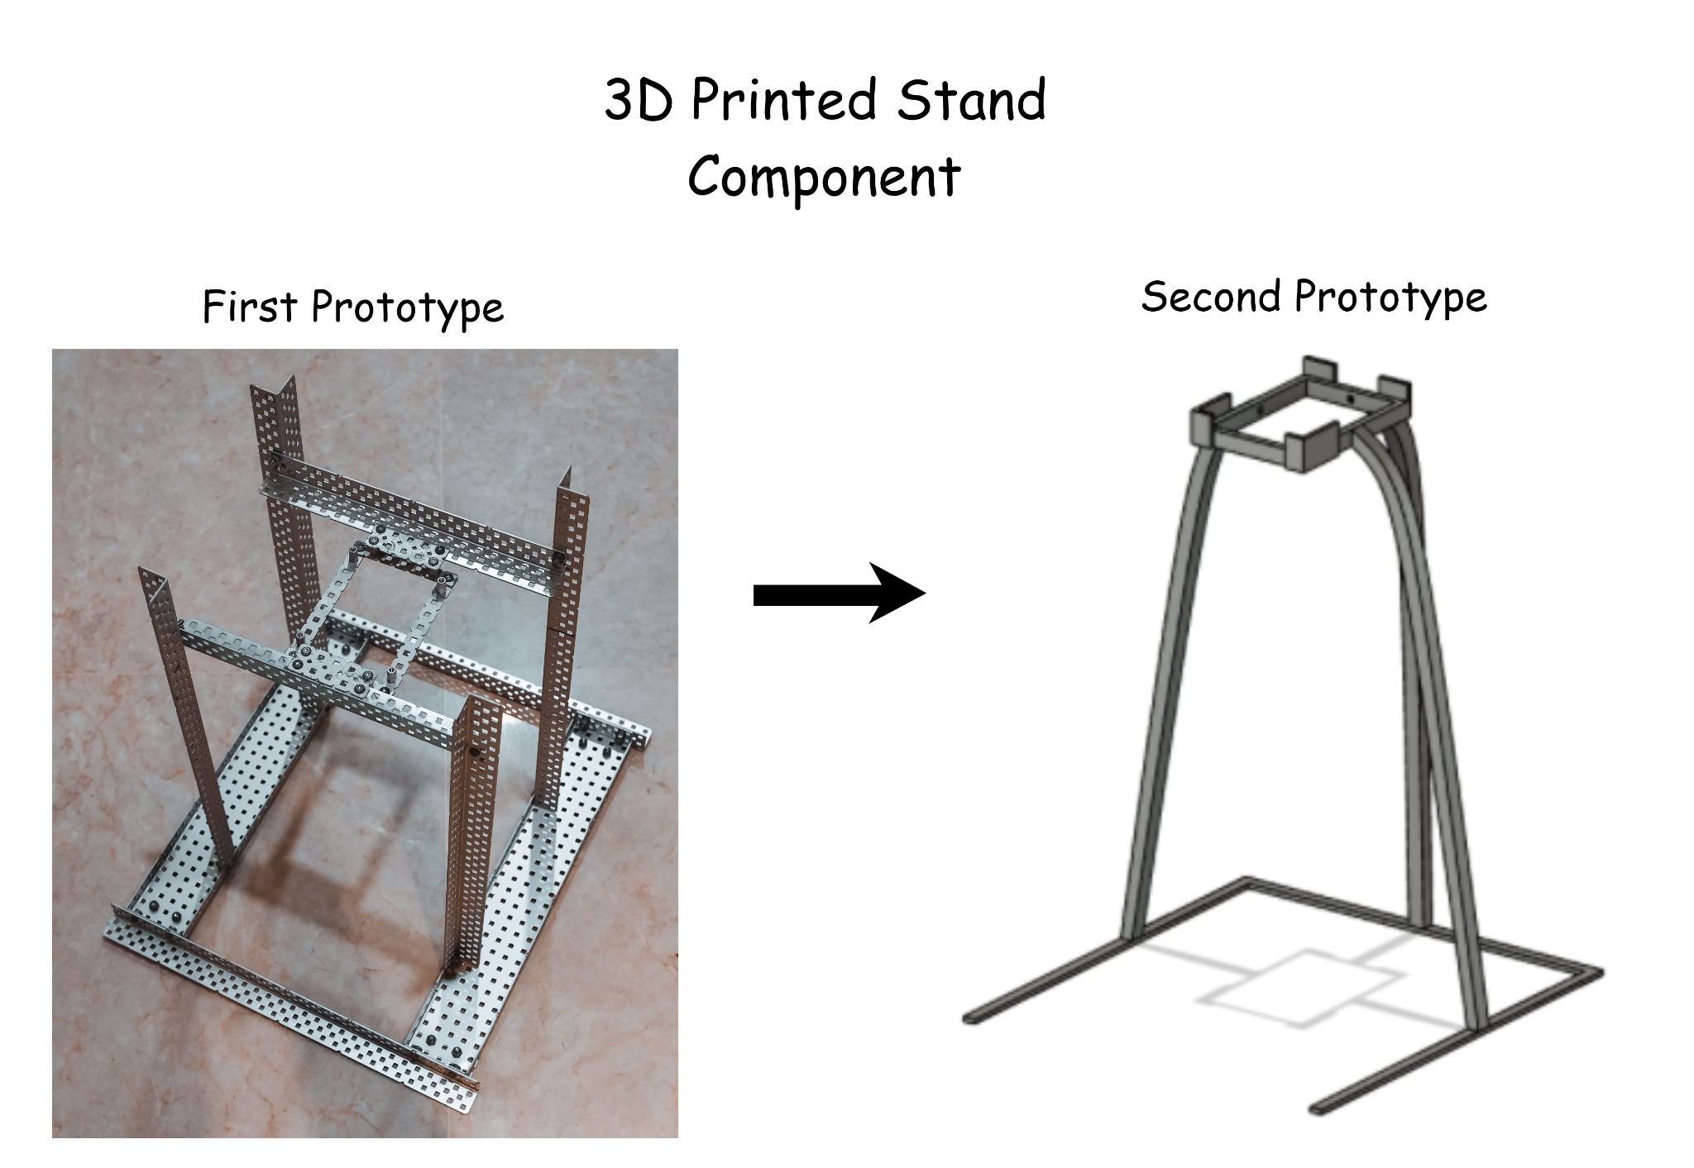
Hardware Components
3D Printed Stand
Notes:
Tremaine: Finally, this is the stand to hold the scanner and it has two prototypes. The plan was to present the second prototype, but due to heightened restrictions, we were unable to find a suitable place to print the stand.

Slide 40
SOFTWARE CODE
GitHub Repository: https://github.com/tremainetan/ProjectBlindEye
Notes:
Tremaine: Moving on, we will show you our code with all the functions collapsed. The full code can be found in our github as linked above and in our written report.

Slide 41
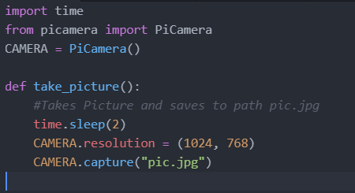
Taking Picture
Notes:
Tremaine: This is the taking picture module,

Slide 42
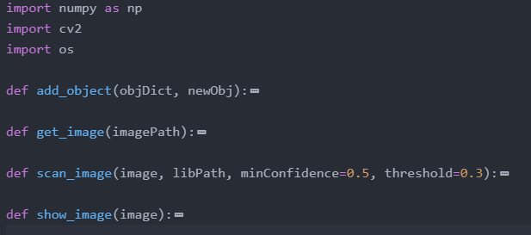
Object Detection
Notes:
Tremaine: ...The object detection module,

Slide 43
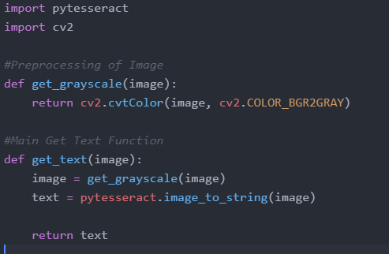
Optical Character Recognition
Notes:
Tremaine: ... The text recognition module,

Slide 44
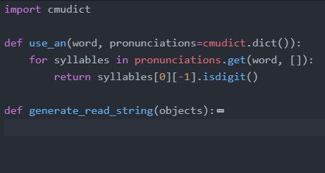
Language Processing
Notes:
Tremaine: ...The language processing module,

Slide 45
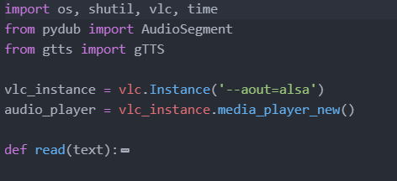
Text to Speech and Playing Audio
Notes:
Tremaine: And finally the TTS module which also plays audio through the speaker. You can see in the code that it uses the ALSA architecture

Slide 46
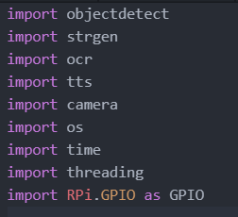
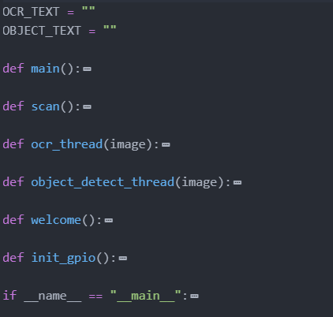
Main Code
Notes:
Tremaine: Here is our main skeleton. You can see that it imports the various modules required, some of them from in-built libraries and the modules we created earlier.

Slide 47
User Testing
Notes:
Tremaine: Now we will move on to our next section, user testing.

Slide 48
User testing
Due to COVID-19 restrictions, we could only conduct pilot testing on our family members
We used the completed scanner and the first prototype of the stand, but showed the 3D model of the stand as well
Notes:
Tremaine: Due to heightened restrictions, we only conducted the testing on our family members. Although the first prototype was physically being used, we showed them a picture of the final prototype of the stand for judging of the design.

Slide 49
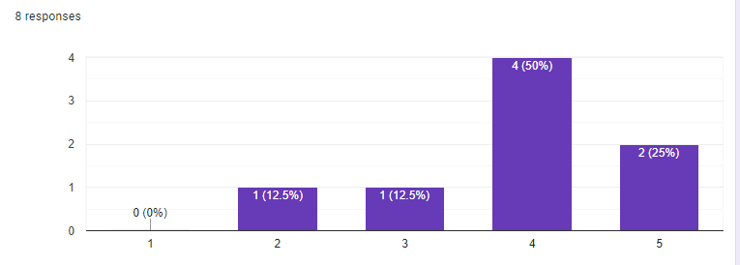
User testing
1)How necessary do you think this project is?
Scale: 1-5, 1: not necessary, 5: very necessary
Notes:
Tremaine: After gathering feedback, we found that majority of the respondents think the project is quite necessary.

Slide 50
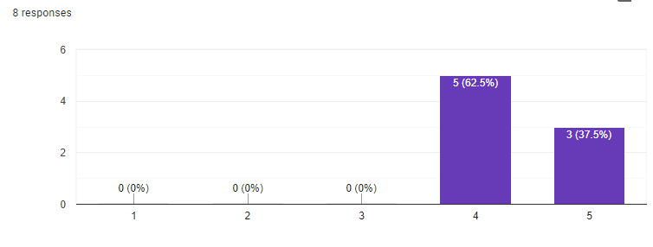
User testing
2) How intuitive is the design of the build?
Scale: 1-5, 1: not intuitive, 5: very intuitive
Notes:
Tremaine: and that the design is quite intuitive

Slide 51
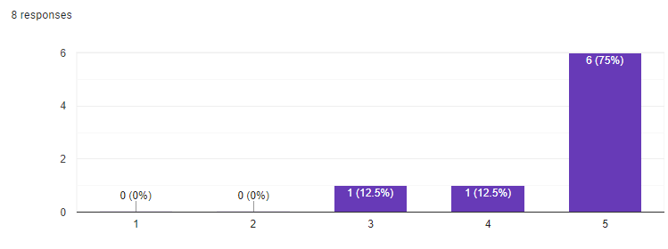
User testing
3) How effective is the scanner in conveying the text message to the user?
Scale: 1-5, 1: least effective, 5: very effective
Notes:
Tremaine: Many of them also think that the text content is well-detected

Slide 52
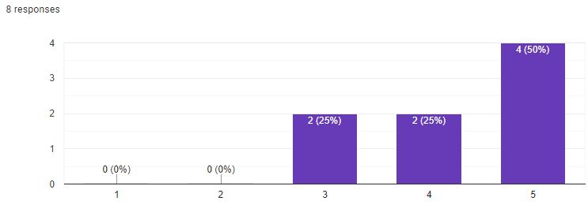
User testing
4) How effective is the scanner in enabling the user to visualise the pictures on the paper?
Scale: 1-5, 1: least, 5: very effective
Notes:
Tremaine: and they found the object detection feature excellent.

Slide 53
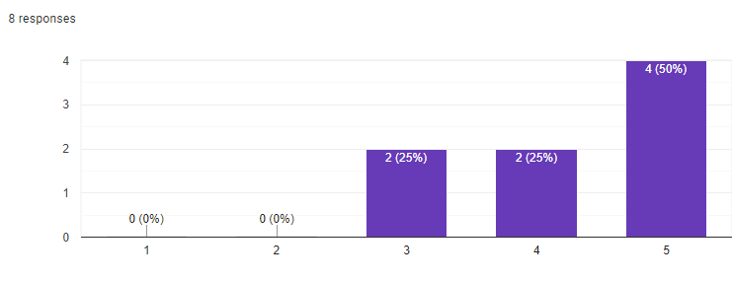
User testing
5) How was your experience using Project Blind Eye?
Scale: 1-5, 1: very bad, 5: very good
Notes:
Tremaine: Finally, half the respondents fully enjoyed the experience, while none of them found the experience bad

Slide 54
User testing
6) Which feature in the prototype do you like the most?
“it can detect images on the paper”
“I like how it can form a sentence with images, making it more clear and understandable than just listing”
“The text to speech sounds quite good”
Notes:
Tremaine: These are some of the features that the users really loved. We can see that they are amused by the object detection capabilities

Slide 55
User testing
7) Areas for improvement:
“Maybe can make into an app”
“Ability to store images”
“Repeat button for text in case they miss it the first time”
Notes:
Tremaine: Next, here are some of the areas of improvements that they stated.

Slide 56
Conclusion from testing
Most people find this project useful and feel that it works well
Many find the image recognition to be useful and interesting as they have already seen text to speech
We have mostly achieved our goal to help the blind
Notes:
Tremaine: To conclude, we are happy that most of them think the project is relatively effective for blind users.
(ASHLEY UNMUTE MIC)

Slide 57
Further extensions
Some of the areas for improvement:
Adding headphone jack
Make it easier for user to hear output
Store images
More convenient for user to access the document again
Repeat button
In case user misses out some details
Adding a battery to the scanner
Scanner should not rely on a computer
Notes:
Tremaine: We compiled the areas of improvements that the project has, such as adding a headphone jack and batteries to the scanner, or even saving the scan history.
(STOP HERE)

Slide 58
Methodology
Notes:
Ashley: Next up, we will present our methodology.

Slide 59





Timeline
April
Research and do the necessary write-ups on libraries used
Complete Proposal Evaluation Slides
May
Complete prototype based on judges’ comments
July
June
Improve Prototype
Beta testing of prototype and obtain user feedback
Complete Written Report and 50% of Final Evaluation Slides
Start working on possible features if time permits
Start working on Mid-Term Evaluation Slides
Start working on Written Report
August
Aim to finish possible features if possible
Complete Final Evaluation Slides
Notes:
Ashley: Here’s our timeline.

Slide 60

Tools Used
Collection of data
Reliable sources like CNA and BBC and online research papers
Development tools
Python with many other libraries
pytesseract
opencv
cmudict
gTTS
Pydub
threading
3D Design tool
Autodesk Fusion 360
Notes:
Ashley: Moving on to our Methodology, we have collected data from reliable sources such as CNA, BBC, and online research papers. We have used python incorporated with some external libraries that we mentioned earlier for the software. Our 3D Design tool will only be Autodesk Fusion 360, and Ultimaker Cura for slicing the 3D Models.

Slide 61
Job Distribution
Notes:
Ashley: Moving on to our job distribution, …...

Slide 62
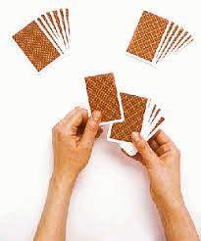
Job Distribution
Code is generally modular based
Main Skeleton
The main program that is running
Imports various modules
Modules are written by respective group members responsible for whichever module
Notes:
Ashley: ……. One of the great aspects of our project is the teamwork. We have a modular code, meaning that it is very easy to cooperate since every group member gets to write code for the different modules that they are responsible for. We will then have a main skeleton program to use the modules and run the program.

Slide 63

Job Distribution - Software Side
Khng Ashley
Camera functionality
Optical Character Recognition (OCR)
Object Detection (Researched and Done Together)
Tan Kwang Yik Tremaine
Main skeleton
Text-to-speech
Object detection (Researched and Done Together)
Code cleanup
Notes:
Ashley: To break down our software components, I am responsible for writing the camera and OCR modules, and Tremaine writes code for the TTS module and main skeleton. The Object Detection module is done together. Furthermore, we have Tremaine to review the code.

Slide 64

Job Distribution - Hardware Side
Khng Ashley
3D design of scanner - Both Casing and Lid
Tan Kwang Yik Tremaine
3D design of stand
Adding snap-fit mechanism to the scanner
Wiring and Soldering of circuit
Notes:
Ashley: To break down our hardware components, I was responsible for designing the stand component of the project and Tremaine designed the scanner and also produced the circuit board.

Slide 65
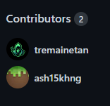


Job Distribution - Teamwork
Workflow
We use GitHub to make sure that everyone contributes to the code
As our code is modular, each person is assigned to a certain module
A new branch is created for testing of new modules
Once done, a pull request is made to merge to the main branch, which is the full code free of bugs
We then perform code reviewing before merging it to the main branch
Notes:
Ashley: Our last part of the Job distribution is the integration part. We write code together using GitHub, and this is our workflow. We mainly use branches for each module and merge it into the main branch once code reviewing is done by the other partner.

Slide 66
Individual Reflections
Notes:
Ashley: Moving on to our reflections, …...

Slide 67
Tremaine
I learnt through our research and study that not much has been done to aid the blind and also learnt a lot about computer vision algorithms which were new to me. As a leader, I had responsibilities regarding distribution of work, planning the next steps that the group should take, and communicating with other group members.
Notes:
Ashley: This is Tremaine’s Reflection

Slide 68
Ashley
I have learnt that although people are more accepting of people with disabilities, many things can still be done to help them. I have learnt more about object recognition algorithms as well as OCR algorithms. I have also gained more knowledge in 3D modelling and design. I have also learnt how to collaborate with others better in projects, especially in programming.
Notes:
Ashley: And this is my reflection

Slide 69
Bibliography
The Braille Literacy Crisis in America. (2009). Retrieved 25 January 2021, from https://www.nfb.org//images/nfb/documents/pdf/braille_literacy_report_web.pdf
Braille Literacy Statistics and How They Relate to Equality. (2016). Retrieved 25 January 2021, from https://brailleworks.com/braille-literacy-statistics/
McDonnall, M., & Cmar, J. L. (2019, October 14). Blind people have increased opportunities, but employers’ perceptions are still a barrier. The Conversation. Retrieved 25 January 2021, from https://theconversation.com/blind-people-have-increased-opportunities-but-employers-perceptions-are-still-a-barrier-124977
Notes:
Ashley: Here are some references, ….

Slide 70
Bibliography Cont.
Sensotec. (2020, November 9). Version (2.9.1). KNFB Reader. https://play.google.com/store/apps/details?id=com.sensotec.knfbreader&amp;hl=en_SG&amp;gl=US
Martin. (2017, April 19). Subtitle Reader. Subtitle reader | Hackaday.io. computer software, hackaday.io. https://hackaday.io/project/21294-subtitle-reader.
Samir, A. (2017, March 23). Deaf-blind Communication Version (1.0). Deaf-blind Communication with 1Sheeld/Arduino - Arduino Project Hub. Arduino. https://create.arduino.cc/projecthub/skyseeker/deaf-blind-communication-with-1sheeld-arduino-bb3362?ref=tag&amp;ref_id=blind&amp;offset=4.
Notes:
Ashley: …, and more references. We have come to the end of our presentation. Thank you for your kind attention.

